Slide 1
CS 204
Stacks and Queues
(not in any book that we are using)
From
Starting out with C++, 7th edition, by Gaddis, Walters and Muganda (chapter 18)

Slide 2
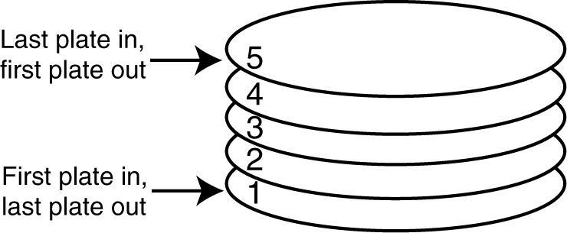
Introduction to the Stack
A stack is a data structure that stores and retrieves items in a last-in-first-out (LIFO) manner.

Slide 3
Applications of Stacks
Computer systems use stacks during a program’s execution to store function return addresses, local variables, etc.
Some calculators use stacks for performing mathematical operations.
Lots of classical CS problems are solved with the help of stacks
  Especially the ones requiring search among several options

Slide 4
Static and Dynamic Stacks
Static Stacks
  Fixed size
  Can be implemented with an array
Dynamic Stacks
  Grow in size as needed
  Can be implemented with a linked list

Slide 5
Stack Operations
Push
  causes a value to be stored in (pushed onto) top of the stack
Pop
  retrieves and removes a value from the top of the stack
  Thus, we need to keep the index of or have a pointer to the top element

Slide 6
The Push Operation
Suppose we have an empty integer stack that is capable of holding a maximum of three values. With that stack we execute the following push operations.
push(5);
push(10);
push(12);

Slide 7
The Push Operation
The state of the stack after each of the push operations:
Empty Stack
push(5);
Push(10);
push(12);
5
10
5
top
12
10
5
top
top
top

Slide 8
The Pop Operation
Now, suppose we execute three consecutive pop operations on the same stack:
pop();
pop();
pop();
12
10
5
5
10
top
5
top
top

Slide 9
Other Useful Stack Functions
isFull: A Boolean function needed for static stacks. Returns true if the stack is full. Otherwise, returns false.
isEmpty: A Boolean operation needed for all stacks. Returns true if the stack is empty. Otherwise, returns false.

Slide 10
A Static Integer Stack Implementation
Using classes (see IntStack.h and IntStack.cpp)
Member Variable Description
stackArray A pointer to int. When the constructor is executed, it uses
stackArray to dynamically allocate an array for storage.
stackSize An integer that holds the size of the stack.
top An integer that is used to mark the top of the stack.

Slide 11
The IntStack Class
Member Functions
Member Function Description
constructor The class constructor accepts an integer argument, which specifies the
size of the stack. An integer array of this size is dynamically
allocated, and assigned to stackArray. Also, the variable top is
initialized to -1.
push The push function accepts an integer argument, which is pushed onto
the top of the stack.
pop The pop function uses an integer reference parameter. The value at
the top of the stack is removed, and copied into the reference
parameter.

Slide 12
The IntStack Class
Member Functions (continued)
Member Function Description
isFull Returns true if the stack is full; returns false otherwise. The stack is
full when top is equal to stackSize - 1.
isEmpty Returns true if the stack is empty, and false otherwise. The stack
is empty when top is set to -1.

Slide 13
Contents of IntStack.h
#ifndef INTSTACK_H
#define INTSTACK_H
class IntStack
{
private:
int *stackArray;
int stackSize;
int top;
public:
IntStack(int);
void push(int);
void pop(int &);
bool isFull(void);
bool isEmpty(void);
};
#endif

Slide 14
Contents of IntStack.cpp
//*******************
// Constructor *
//*******************
IntStack::IntStack(int size)
{
stackArray = new int[size];
stackSize = size;
top = -1;
}

Slide 15
Contents of IntStack.cpp
//*************************************************
// Member function push pushes the argument onto *
// the stack. *
//*************************************************
void IntStack::push(int num)
{
if (isFull())
{
cout << "The stack is full.\n";
}
else
{
top++;
stackArray[top] = num;
}
}

Slide 16
Contents of IntStack.cpp
//****************************************************
// Member function pop pops the value at the top *
// of the stack off, and copies it into the variable *
// passed as an argument. *
//****************************************************
void IntStack::pop(int & num)
{
if (isEmpty())
{
cout << "The stack is empty.\n";
}
else
{
num = stackArray[top];
top--;
}
}

Slide 17
Contents of IntStack.cpp
//***************************************************
// Member function isFull returns true if the stack *
// is full, or false otherwise. *
//***************************************************
bool IntStack::isFull(void)
{
bool status;
if (top == stackSize - 1)
status = true;
else
status = false;
return status;
}

Slide 18
Contents of IntStack.cpp
//****************************************************
// Member funciton isEmpty returns true if the stack *
// is empty, or false otherwise. *
//****************************************************
bool IntStack::isEmpty(void)
{
bool status;
if (top == -1)
status = true;
else
status = false;
return status;
}

Slide 19
Demo Program (IntStackDemo.cpp)
#include "intstack.h"
#include <iostream>
using namespace std;
int main()
{
IntStack stack(5);
int num;
cout << "Created an empty stack with capacity 5, trying to pop. \n";
stack.pop(num);
int values[] = {2, 7, 10, 5, 3, 8, 11};
cout << "\nPushing...\n";
for (int k = 0; k < 7; k++)
{
cout << values[k] << " ";
stack.push(values[k]);
cout << endl;
}
cout << "\nPopping...\n";
while (!stack.isEmpty())
{
stack.pop(num);
cout << num << endl;
}
cout << endl;
return 0;
}
Created an empty stack with capacity 5, trying to pop.
The stack is empty.
Pushing...
2
7
10
5
3
8 The stack is full.
11 The stack is full.
Popping...
3
5
10
7
2

Slide 20
Dynamic Stacks
A dynamic stack is built on a linked list instead of an array.
A linked list-based (dynamic) stack offers two advantages over an array-based (static) stack.
  No need to specify the size of the stack.
    A dynamic stack simply starts as an empty linked list, and then expands by one node each time a value is pushed.
      When a value is popped, its memory is freed.
  A dynamic stack will never be full, as long as the system has enough free memory.
Next couple of slides give an implementation of a dynamic integer stack using classes (see DynIntStack.h and DynIntStack.cpp)

Slide 21
Contents of DynIntStack.h
struct StackNode
{
int value;
StackNode *next;
};
class DynIntStack
{
private:
StackNode *top;
public:
DynIntStack(void);
void push(int);
void pop(int &);
bool isEmpty(void);
};
top
_____
___
_

Slide 22
Contents of DynIntStack.cpp
//************************************************
// Constructor to generate an empty stack. *
//************************************************
DynIntStack::DynIntStack()
{
top = NULL;
}

Slide 23
Contents of DynIntStack.cpp
//************************************************
// Member function push pushes the argument onto *
// the stack. *
//************************************************
void DynIntStack::push(int num)
{
StackNode *newNode;
// Allocate a new node & store Num
newNode = new StackNode;
newNode->value = num;
// If there are no nodes in the list
// make newNode the first node
if (isEmpty())
{
top = newNode;
newNode->next = NULL;
}
else // Otherwise, insert NewNode before top
{
newNode->next = top;
top = newNode;
}
}

Slide 24
Contents of DynIntStack.cpp
/****************************************************
// Member function pop pops the value at the top *
// of the stack off, and copies it into the variable *
// passed as an argument. *
//****************************************************
void DynIntStack::pop(int & num)
{
StackNode *temp;
if (isEmpty())
{
cout << "The stack is empty.\n";
}
else // pop value off top of stack
{
num = top->value;
temp = top->next;
delete top;
top = temp;
}
}

Slide 25
Contents of DynIntStack.cpp
//****************************************************
// Member funciton isEmpty returns true if the stack *
// is empty, or false otherwise. *
//****************************************************
bool DynIntStack::isEmpty(void)
{
bool status;
if (top == NULL)
status = true;
else
status = false;
return status;
}

Slide 26
Demo Program (DynIntStackDemo.cpp)
// This program demonstrates the dynamic stack class DynIntStack.
#include <iostream>
#include "DynIntStack.h"
using namespace std;
int main()
{
DynIntStack stack;
int catchVar;
// Push values 5, 10, and 15 on the stack
for (int value = 5; value <=15; value = value + 5)
{
cout << "Push: " << value << "\n";
stack.push(value);
}
cout << "\n";
//Pop three values, then attempt a fourth pop
for (int k = 1; k <= 3; k++)
{
cout << "Pop: ";
stack.pop(catchVar);
cout << catchVar << endl;
}
cout << "\nAttempting to pop again... ";
stack.pop(catchVar);
return 0;
}
Push: 5
Push: 10
Push: 15
Pop: 15
Pop: 10
Pop: 5
Attempting to pop again... The stack is empty.

Slide 27
A Case Study: Postfix Expression Evaluator
Infix expressions
  Operator is between the operands
  e.g. 4 + 7
Postfix expressions
  Operator is after the operands
  e.g. 4 7 +
  In more complex expressions
    When an operator is seen, it is applied to the previous two operands and the result is replaced.
  No need to use parantheses; no operator precedence to imply the order of evaluation in complex expressions (see the examples in the next slide).

Slide 28
Postfix Expressions
Postfix Expression Infix Expression Value
4 7 * 4 * 7 28
4 7 2 + * 4 * (7 +2) 36
4 7 * 9 - 4 * 7 - 9 19
3 4 7 * 2 / + 3+ 4 * 7 / 2 17

Slide 29
Postfix Expression Evaluator – Algorithm
Scan the expression from left to right
  If next token is an operand
    Push it to the stack
  If next token is an operator
    Pop from the stack – this is the rhs operand
    Pop from the stack – this is the lhs operand
    Apply operator on these operands
    Push the result to the stack
When expression is finished
  Pop from the stack, this is the result of expression
Let's trace this algorithm on 4 7 2 + * 9 - (see the board)

Slide 30
Postfix Expression Evaluator – Implementation
We use integer stack to store the operands and intermediate results
For the sake on simplicity in expression parsing
  We assume that expression is a valid postfix expression
  We assume single digit operands in the expression so that we can read char by char
    of course, intermediate results may be larger
See next slide for the code (PostfixEvaluator.cpp)

Slide 31
DynIntStack stack;
char token;
int rhs, lhs, result;
cout << "Please enter postfix expression: ";
while (cin >> token) //as long as there is input
{
if (token >= '0' && token <= '9') //if digit
{
stack.push(token - '0'); //push it to stack
}
else //if operator
{
stack.pop(rhs);
stack.pop(lhs); // pop two operands
//and apply the operations. Result is pushed to the stack
if (token == '+')
stack.push(lhs + rhs);
else if (token == '-')
stack.push(lhs - rhs);
else if (token == '*')
stack.push(lhs * rhs);
else if (token == '/')
stack.push(lhs / rhs);
}
}
//after while, the stack contains only the final result, pop it and display
stack.pop(result);
cout << "result is: " << result << endl;

Slide 32
Introduction to the Queue
Like a stack, a queue is a data structure that holds a sequence of elements.
A queue, however, provides access to its elements in first-in, first-out (FIFO) order.
The elements in a queue are processed like customers standing in a grocery check-out line: the first customer in line is the first one served.

Slide 33
Example Applications of Queues
In a multi-user system, a queue is used to hold print jobs submitted by users, while the printer services those jobs one at a time.
Communications software also uses queues to hold information received over networks. Sometimes information is transmitted to a system faster than it can be processed, so it is placed in a queue when it is received.

Slide 34
Static and Dynamic Queues
Just as stacks, queues are implemented as arrays or linked lists.
Dynamic queues offer the same advantages over static queues that dynamic stacks offer over static stacks.

Slide 35
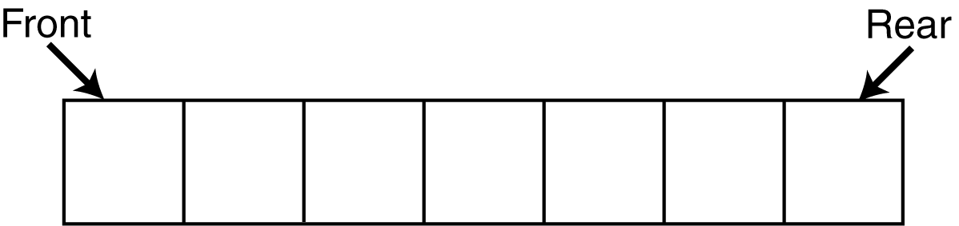
Queue Operations
Think of queues as having a front and a rear.
  rear: position where elements are added
  front: position from which elements are removed

Slide 36
Queue Operations
The two primary queue operations are enqueuing and dequeuing.
To enqueue means to insert an element at the rear of a queue.
To dequeue means to remove an element from the front of a queue.

Slide 37
Queue Operations
Suppose we have an empty static integer queue that is capable of holding a maximum of three values. With that queue we execute the following enqueue operations.
Enqueue(3);
Enqueue(6);
Enqueue(9);

Slide 38
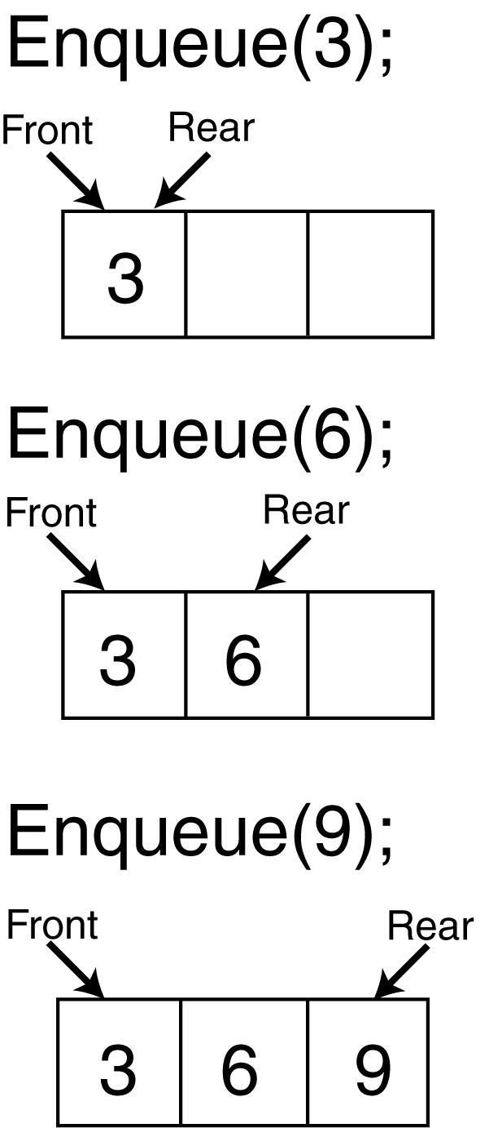
Queue Operations - Enqueue
The state of the queue after each of the enqueue operations.

Slide 39
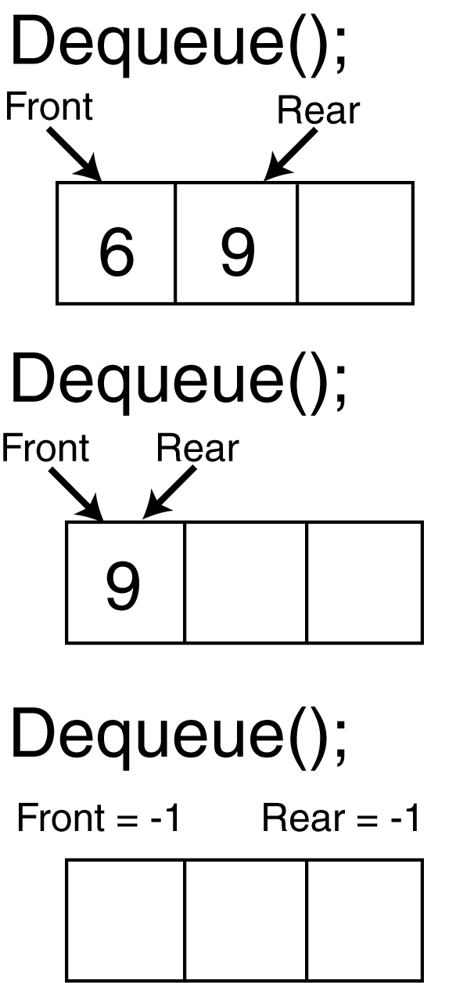
Queue Operations - Dequeue
Now let's see how dequeue operations are performed. The figure on the right shows the state of the queue after each of three consecutive dequeue operations
An important remark
  After each dequeue, remaining items shift toward the front of the queue.
3 removed
6 removed
9 removed

Slide 40
Efficiency Problem of Dequeue & Solution
Shifting after each dequeue operation causes ineffiency.
Solution
  Let front index move as elements are removed
  let rear index "wrap around" to the beginning of array, treating array as circular
    Similarly, the front index as well
  Yields more complex enqueue, dequeue code, but more efficient
  Let's see the trace of this method on the board for the enqueue and dequeue operations given on the right (queue size is 3)
Enqueue(3);
Enqueue(6);
Enqueue(9);
Dequeue();
Dequeue();
Enqueue(12);
Dequeue();

Slide 41
Implementation of a Static Queue
The previous discussion was about static arrays
  Container is an array
Class Implementation for a static integer queue
  Member functions
    enqueue
    dequeue
    isEmpty
    isFull
    clear

Slide 42
Contents of IntQueue.h
#ifndef INTQUEUE_H
#define INTQUEUE_H
class IntQueue
{
private:
int *queueArray;
int queueSize; //capacity of queue
int front;
int rear;
int numItems; //# of elements currently in the queue
public:
IntQueue(int); //constructor, parameter is capacity
void enqueue(int);
void dequeue(int &);
bool isEmpty() const;
bool isFull() const;
void clear(); //removes all elements
};
#endif

Slide 43
Contents of IntQueue.cpp
#include <iostream>
#include "IntQueue.h"
using namespace std;
//*****************************************
// Constructor - creates an empty queue *
// with given number of elements *
//*****************************************
IntQueue::IntQueue(int s)
{
queueArray = new int[s];
queueSize = s;
front = -1;
rear = -1;
numItems = 0;
#ifdef _DEBUG
cout << "A queue with " << s << " elements created\n";
#endif
}

Slide 44
Contents of IntQueue.cpp
//********************************************
// Function enqueue inserts the value in num *
// at the rear of the queue. *
//********************************************
void IntQueue::enqueue(int num)
{
if (isFull())
{
cout << "The queue is full. " << num << " not enqueued\n";
}
else
{
// Calculate the new rear position circularly.
rear = (rear + 1) % queueSize;
// Insert new item.
queueArray[rear] = num;
// Update item count.
numItems++;
#ifdef _DEBUG
cout << num << " enqueued\n";
#endif
}
}

Slide 45
Contents of IntQueue.cpp
//**********************************************
// Function dequeue removes the value at the *
// front of the queue, and copies it into num. *
//**********************************************
void IntQueue::dequeue(int & num)
{
if (isEmpty())
{
cout << "Attempting to dequeue on empty queue, exiting program...\n";
exit(1);
}
else
{
// Move front.
front = (front + 1) % queueSize;
// Retrieve the front item.
num = queueArray[front];
// Update item count.
numItems--;
}
}

Slide 46
Contents of IntQueue.cpp
//*********************************************
// Function isEmpty returns true if the queue *
// is empty, and false otherwise. *
//*********************************************
bool IntQueue::isEmpty() const
{
if (numItems > 0)
return false;
else
return true;
}
Open Question: How would we understand that queue is empty without using numItems (i.e. using only front and rear)?

Slide 47
Contents of IntQueue.cpp
//********************************************
// Function isFull returns true if the queue *
// is full, and false otherwise. *
//********************************************
bool IntQueue::isFull() const
{
if (numItems < queueSize)
return false;
else
return true;
}
Open Question: How would we understand that queue is full without using numItems (i.e. using only front and rear)?

Slide 48
Contents of IntQueue.cpp
//*******************************************
// Function clear resets the front and rear *
// indices, and sets numItems to 0. *
//*******************************************
void IntQueue::clear()
{
front = - 1;
rear = - 1;
numItems = 0;
#ifdef _DEBUG
cout << "queue cleared\n";
#endif
}

Slide 49
Demo Program
Let's see and run IntQueueDemo.cpp
  demonstrates the IntQueue class

Slide 50
Dynamic Queues
Like a stack, a queue can be implemented using a linked list
Allows dynamic sizing, avoids issue of shifting elements or wrapping indices
NULL
front
rear

Slide 51
Dynamic Queues
A dynamic queue starts as an empty linked list (both front and rear pointers are set to NULL).
With the first enqueue operation, a node is added, which is pointed to by front and rear pointers.
As each new item is added to the queue, a new node is added to the rear of the list, and the rear pointer is updated to point to the new node.
As each item is dequeued, the node pointed to by the front pointer is deleted, and front is made to point to the next node in the list.
See the next slides for the implementation of an integer dynamic queue.

Slide 52
Contents of DynIntQueue.h
struct QueueNode
{
int value;
QueueNode *next;
QueueNode(int num, QueueNode *ptr = NULL)
{
value = num;
next = ptr;
}
};
class DynIntQueue
{
private:
// These track the front and rear of the queue.
QueueNode *front;
QueueNode *rear;
public:
DynIntQueue(); // Constructor.
// Member functions.
void enqueue(int);
void dequeue(int &);
bool isEmpty() const;
void clear();
};

Slide 53
Contents of DynIntQueue.cpp
#include <iostream>
#include "DynIntQueue.h"
using namespace std;
//************************************************
// Constructor. Generates an empty queue *
//************************************************
DynIntQueue::DynIntQueue()
{
front = NULL;
rear = NULL;
#ifdef _DEBUG
cout << "An empty queue has been created\n";
#endif
}

Slide 54
Contents of DynIntQueue.cpp
//********************************************
// Function enqueue inserts the value in num *
// at the rear of the queue. *
//********************************************
void DynIntQueue::enqueue(int num)
{
if (isEmpty()) //if the queue is empty
{ //make it the first element
front = new QueueNode(num);
rear = front;
}
else //if the queue is not empty
{ //add it after rear
rear->next = new QueueNode(num);
rear = rear->next;
}
#ifdef _DEBUG
cout << num << " enqueued\n";
#endif
}

Slide 55
Contents of DynIntQueue.cpp
//**********************************************
// Function dequeue removes the value at the *
// front of the queue, and copies it into num. *
//**********************************************
void DynIntQueue::dequeue(int &num)
{
QueueNode *temp;
if (isEmpty())
{
cout << "Attempting to dequeue on empty queue, exiting program...\n";
exit(1);
}
else //if the queue is not empty
{ //return front's value, advance front and delete old front
num = front->value;
temp = front;
front = front->next;
delete temp;
}
}

Slide 56
Contents of DynIntQueue.cpp
//*********************************************
// Function isEmpty returns true if the queue *
// is empty, and false otherwise. *
//*********************************************
bool DynIntQueue::isEmpty() const
{
if (front == NULL)
return true;
else
return false;
}

Slide 57
Contents of DynIntQueue.cpp
//********************************************
// Function clear dequeues all the elements *
// in the queue. *
//********************************************
void DynIntQueue::clear()
{
int value; // Dummy variable for dequeue
while(!isEmpty())
dequeue(value); //delete all elements
#ifdef _DEBUG
cout << "queue cleared\n";
#endif
}

Slide 58
Demo Program
Let's see and run DynIntQueueDemo.cpp
  demonstrates the DynIntQueue class

